Slide 1

AEC COURSE PROJECT
QUADRATURE DOWN CONVERTER
GARIMA MITTAL
HARSHITA KUMARI

Slide 2
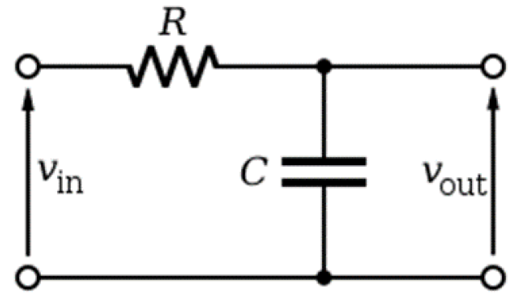
LOW PASS FILTER: A low pass filter (LPF) is an essential electronic component that allows signals with a frequency lower than a specific threshold, known as the cutoff frequency, to pass through it while attenuating (reducing) components of the signal that are higher than this frequency. The purpose of a low pass filter is to eliminate unwanted high-frequency noise and to smooth the output of signals.

Slide 3
Basic implementation of a RC circuit:
Resistor (R): This component restricts the flow of electric current, creating a voltage drop across its terminals according to Ohm's Law.
Capacitor (C): Capacitors store and release electrical energy, and their ability to pass alternating current (AC) depends on the frequency of the AC signal. The impedance of a capacitor decreases as the frequency increases, making it more conductive at higher frequencies.

Slide 4
BASIC WORKING OF A RC CIRCUIT:
When a signal enters an RC low pass filter, both the resistor and the capacitor influence its behaviour:
Voltage Divider: The resistor and capacitor form a voltage divider circuit. The output voltage of the filter is measured across the capacitor.
Frequency Response: At low frequencies, the capacitor’s impedance is high relative to the resistor, so most of the input voltage appears across the capacitor, and thus, the signal passes through unchanged. At high frequencies, the capacitor’s impedance is lower, allowing more of the signal to drop across the resistor and less across the capacitor, effectively attenuating the signal.

Slide 5
EXPLANATION OF OUTPUT:
The reactance of the capacitor in the above picture is given by: XC = 1/jωC.
From this formula, we can see that the reactance is inversely proportional to the angular frequency. This means that as the frequency of the input signal increases, the reactance decreases. At Low Frequencies: When ω (angular frequency) is small, ωCR is also insignificant compared to 1. Therefore, 1+ωCR 1 ≈1, and Vout ≈Vin. This indicates that low-frequency signals pass through the filter with little attenuation.
At High Frequencies: As ω increases, ωCR becomes much larger than 1. The term 1+ωCR becomes much smaller, approaching zero. Thus, Vout is significantly reduced compared to Vin, leading to the attenuation of high-frequency signals. The nature of the capacitor's reactance explains why a low pass filter attenuates high-frequency signals:
Low ω (Frequency): High reactance means fewer current flows through the capacitor, and more voltage is dropped across it, allowing the signal to pass with less attenuation. High ω (Frequency): Low reactance allows more current to flow through the capacitor, resulting in a greater voltage drop across the resistor and less across the capacitor, which means the high-frequency signal components are significantly reduced.

Slide 6
MATHEMATICAL DERICATION OF A LOW PASS FILTER:
The cutoff frequency of the low pass filter can be calculated as follows:
Using KVL:
VOUT = XC · (Vin/XC+XR), where XC and XR are the impedances of the capacitor and resistor, respectively.
Vout/Vin = XC/XC+XR (1)
To obtain the -3dB frequency of the given response, we proceed as follows.
−3 = 20log|(Vout/Vin) | (2)
From equation (1),
|Vout/Vin| = √ (1/1+(ωRC)2) (3)
Solving equations (2) and (3), we get
ω = 1/RC
fC = 1/2πRC, where fC is the cutoff frequency of the filter.

Slide 7
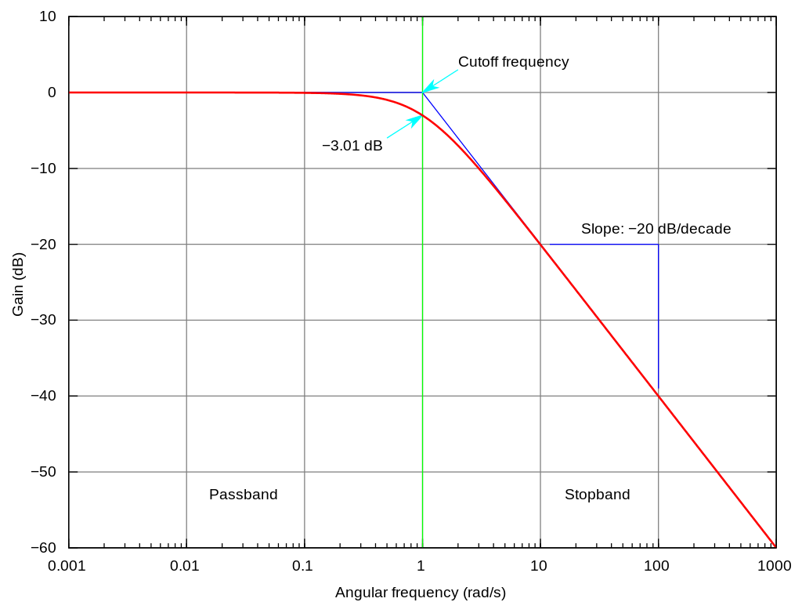
Amplitude vs frequency graph should look like this.

Slide 8
FOR THE GIVEN PROBLEM:
Given that the –3dB cutoff of the low pass filter should be 2kHz.
Thus, fC should be equal to 2kHz.
2*10^3 = 1/2πRC.
Using this equation, we choose the values of R and C such that fC becomes close to 2.8kHz as if the –3dB cutoff frequency comes out to be 2kHz then there will be attenuation at 2kHz also which we do not want, we want input of 2Khz to pass through the filter without any attenuation thus taking a value of –3dB cutoff greater than 2kHz.
Taking R and C values of the low pass filter as follows:
R = 1.26kohm C = 47nF

Slide 9
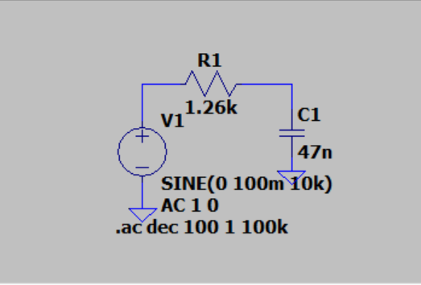
CIRCUIT:

Slide 10
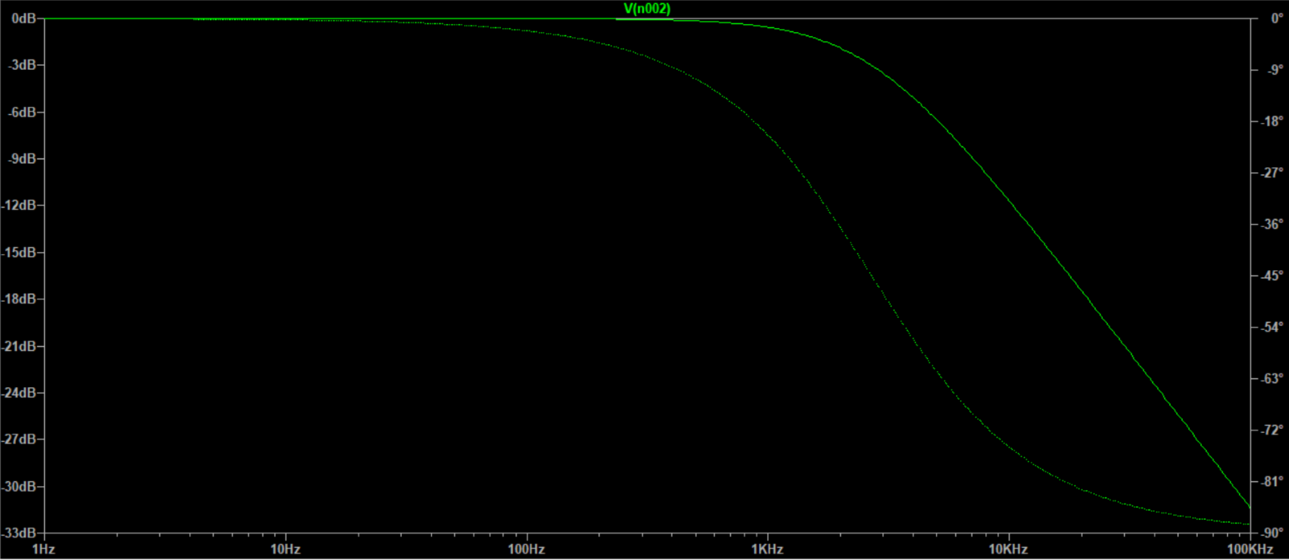
Frequency response (output magnitude vs frequency) from AC analysis:

Slide 11
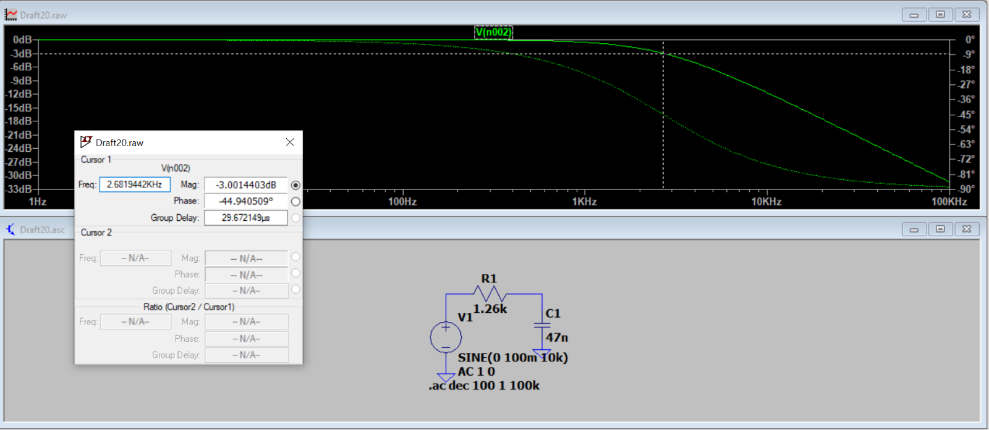
-3dB cutoff frequency:

Slide 12
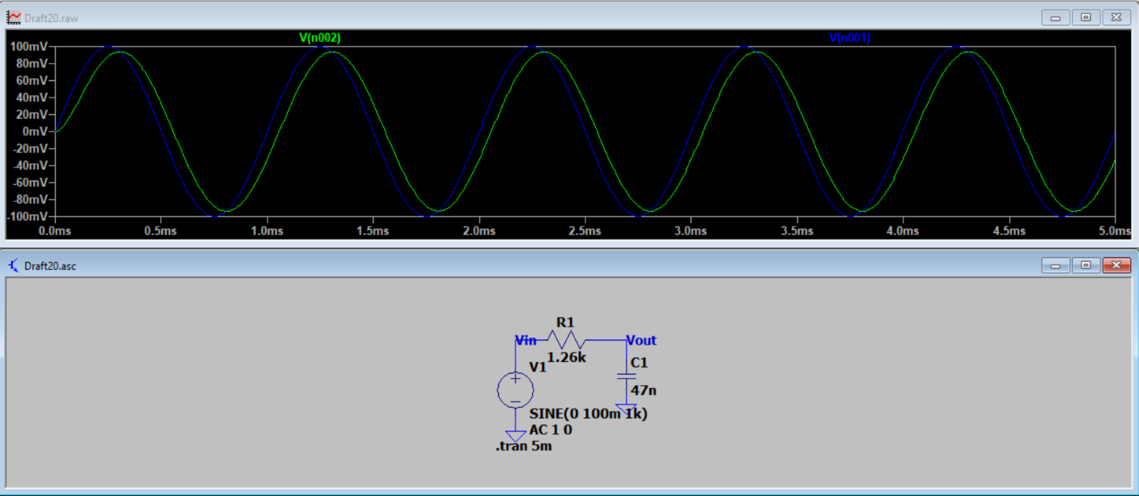
Transient response for 1 kHz signal:

Slide 13
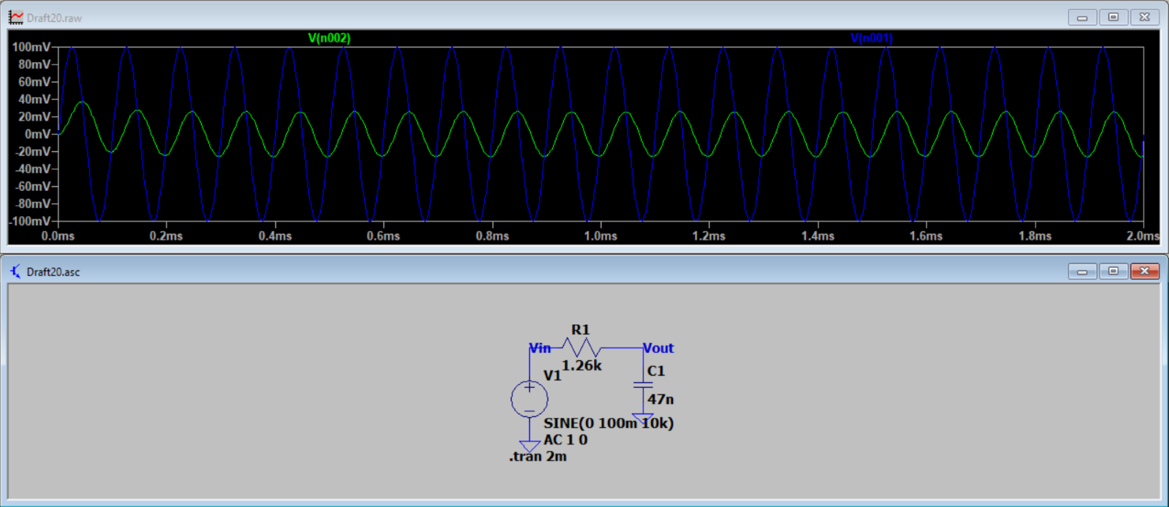
Transient response for 10 kHz signal:
Transient response for 10 kHz signal:

Slide 14
OBSERVATIONS:
Low pass filters (LPFs) are designed to allow signals with frequencies below a predetermined threshold, known as the cutoff frequency, to pass through with minimal or no attenuation, while attenuating signals with frequencies above this threshold.
From the above plots, we can see that the input signals which have frequency lower than that of the cutoff are minimally attenuated(1kHz) i.e. the output and the input signals are almost equal, while the input signals with frequency more than the cutoff are highly attenuated(10kHz) i.e. the most of the output signal is attenuated because the low pass filter does not allow frequencies above 2kHz to pass through it.

Slide 15
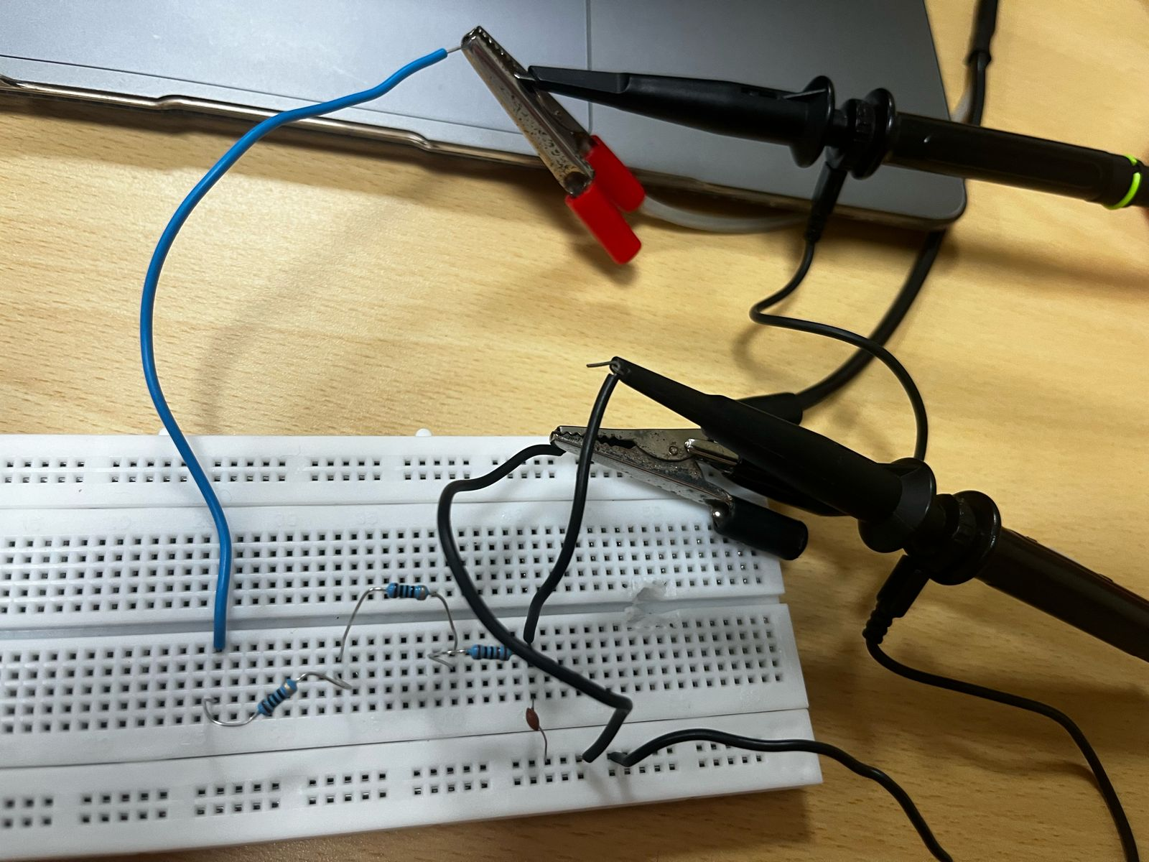
CIRCUIT:

Slide 16
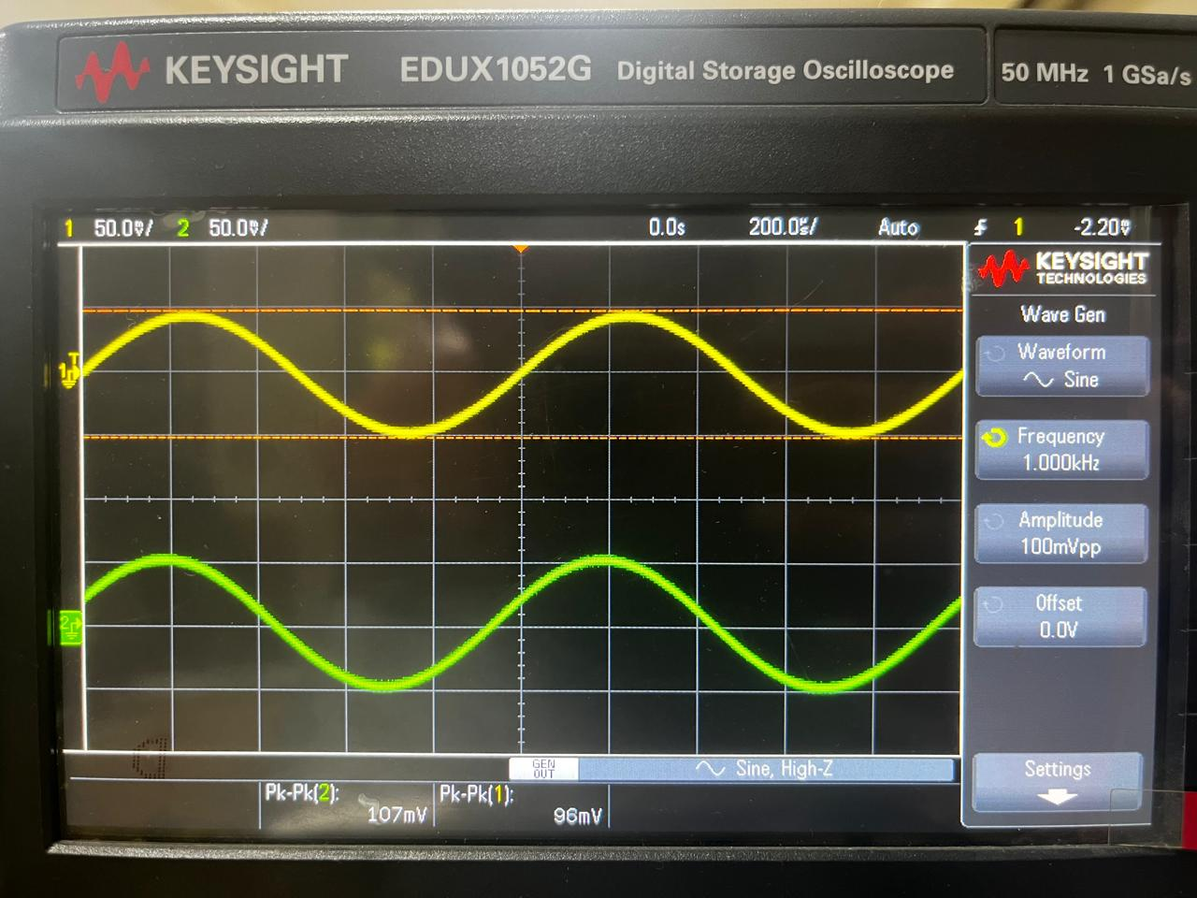
ON DSO 1kHz

Slide 17
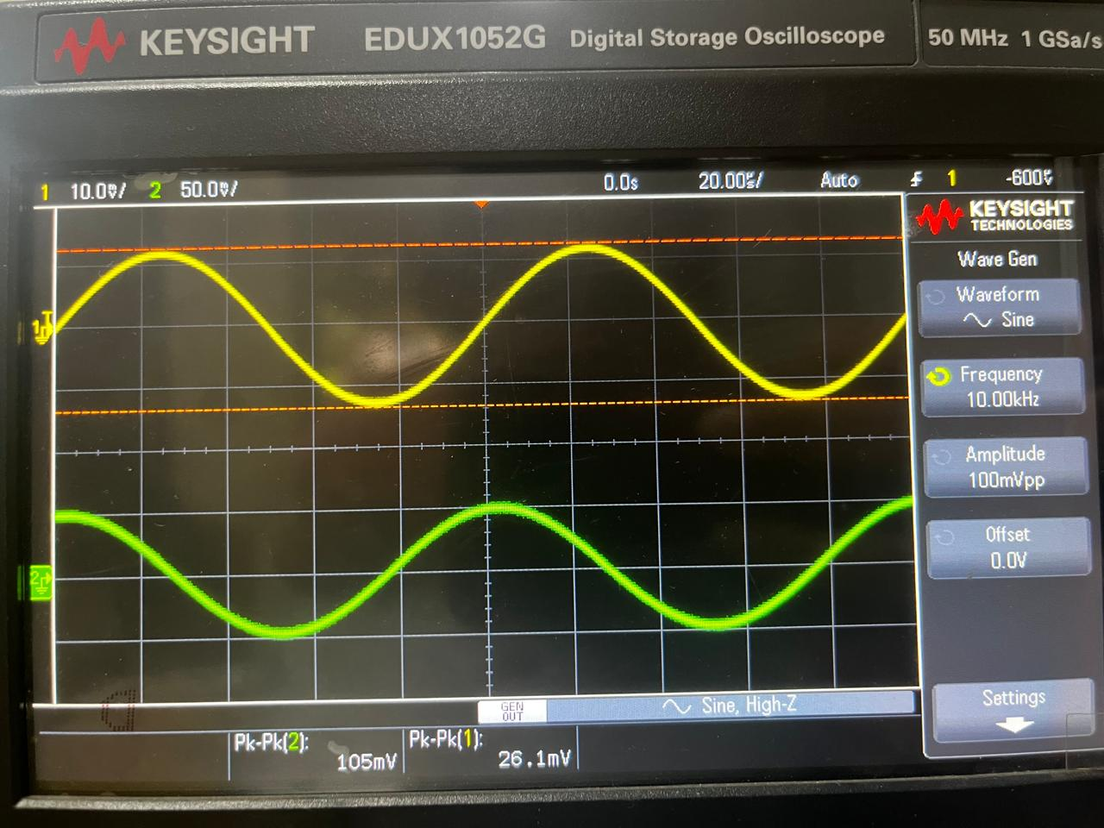
ON DSO 10kHz

Slide 18
SWITCH MIXER: MOSFET works as a switch under the principle: It acts as resistor in linear or triode mode In cutoff region no current flows through it i.e. acts as open circuit.

Slide 19
CUTOFF REGION:
Gate Voltage Below Threshold: In the cutoff region, the MOSFET behaves like an open switch. This state occurs when the voltage applied to the gate (relative to the source) is below the MOSFET's threshold voltage (Vth).
Depleted Channel: With the gate voltage below Vth, there is no significant electric field to attract electrons from the semiconductor material beneath the oxide layer. As a result, the channel between the source and drain is depleted or very narrow, hindering the flow of current.
High Resistance: Due to the depleted channel, the MOSFET exhibits a high resistance between the source and drain terminals. This high resistance effectively prevents any substantial current from flowing through the device.

Slide 20
SATURATION REGION:
Gate Voltage Above Threshold: In the saturation region, the MOSFET behaves like a closed switch. This state occurs when the voltage applied to the gate exceeds the MOSFET's threshold voltage (Vth).
Conductive Channel Formation: When the gate voltage is sufficiently high (typically a few volts above Vth), an electric field is created that attracts electrons from the semiconductor material, forming a conductive channel between the source and drain.
Low Resistance: With the conductive channel fully formed, the MOSFET exhibits a low resistance (ideally, it behaves like a short circuit) between the source and drain terminals. This low resistance allows a significant current to flow through the device with minimal voltage drop.
Saturated Switch: In this state, the MOSFET is said to be saturated, meaning it is fully turned on as a switch, and it can conduct current between the source and drain terminals without significant impedance.

Slide 21
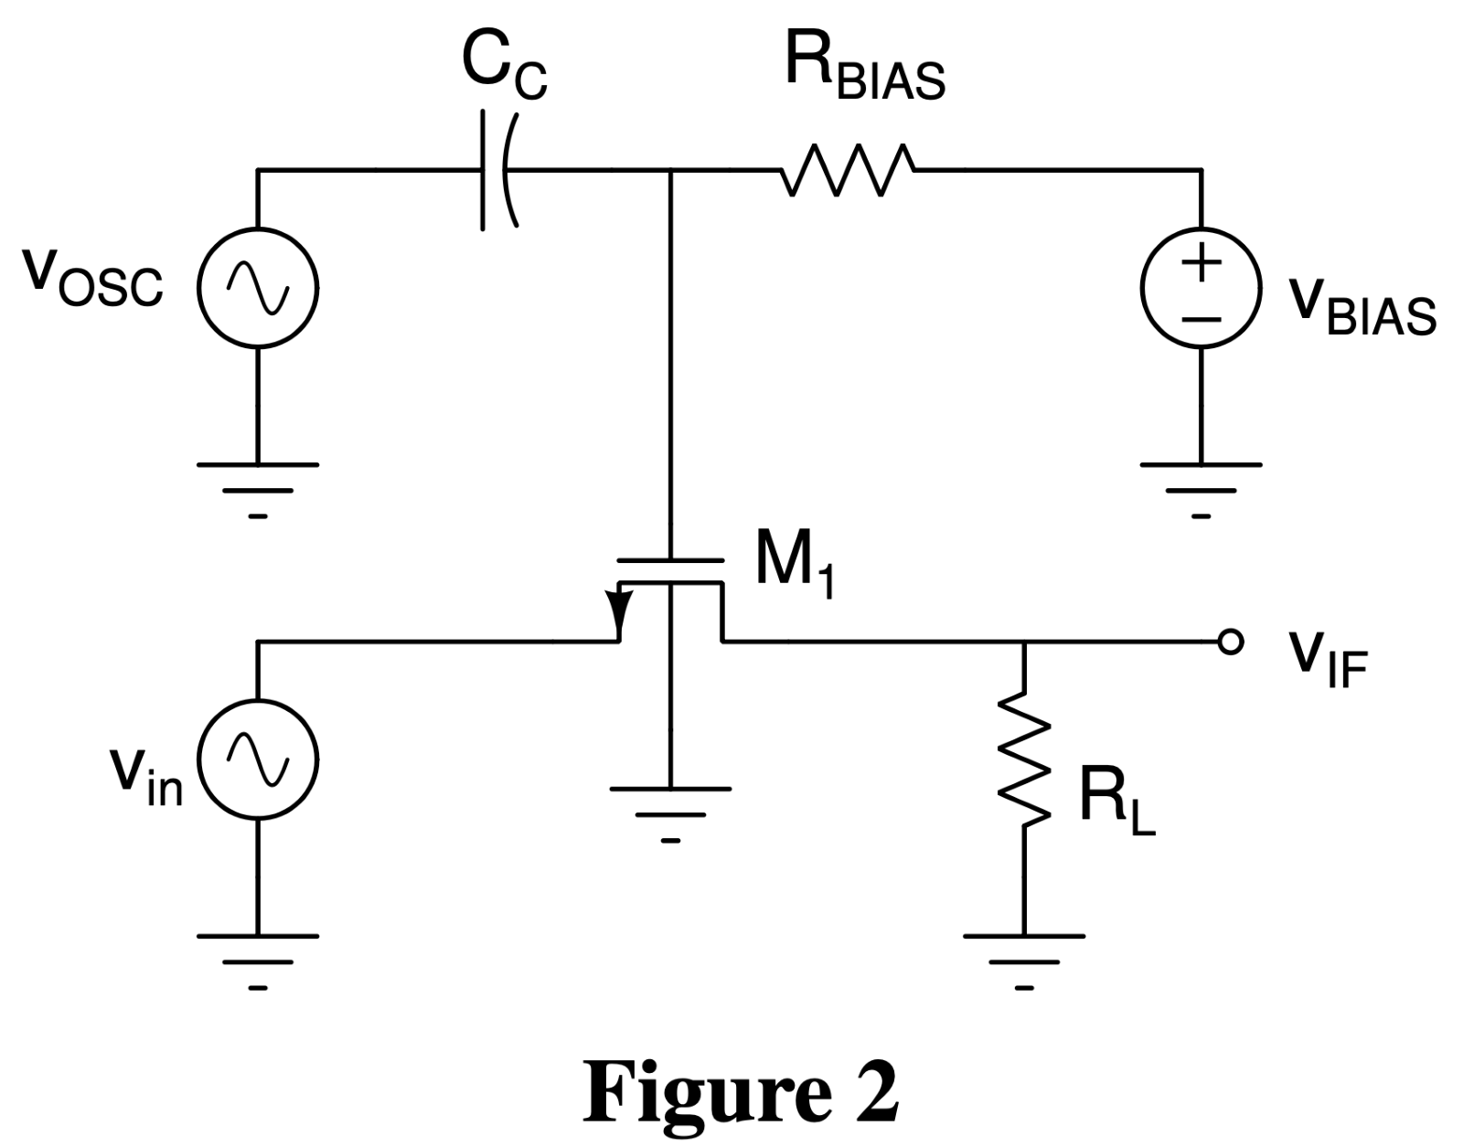

Slide 22
DECIDING Vbias OF THE SWITCH:
The rapid change of MOSFET from triode to saturation and visa-versa is possible when VGS of MOSFET is biased around Vth.
When the gate is biased close to the threshold voltage of the MOSFET, during the positive have of the gate signal (which is generated using the quadrature oscillator), the MOSFET is in linear mode, and during the negative cycle the MOSFET is in cut off mode.

Slide 23
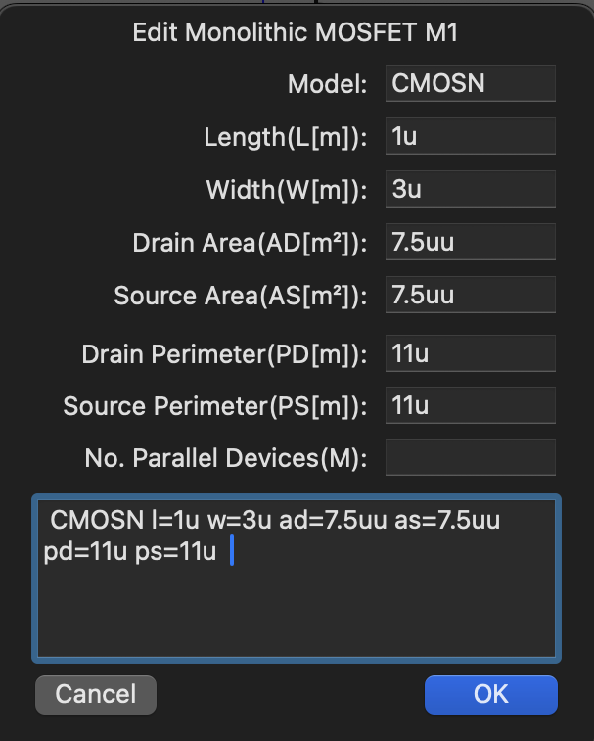
MOSFET PARAMETERS:

Slide 24
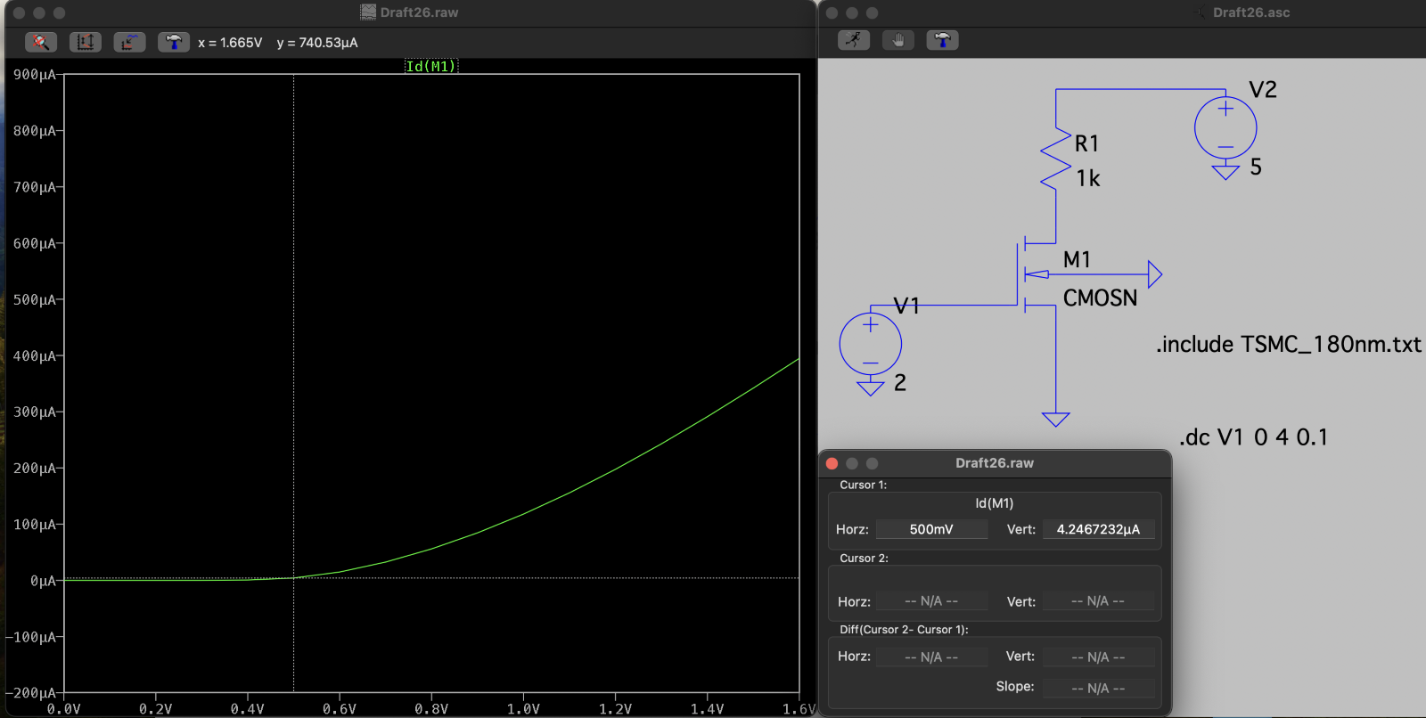
FINDING Vth OF MOSFET:
From the below simulation Vth of the MOSFET is found to be 0.5V

Slide 25
COMPONENTS OF THE SWITCH:
The output of the switch is equivalent to multiplying the input signal at source of MOS- FET to a square wave. When a signal is transmitted, it is first modulated to avoid the effect of noise while communicating over larger distances. This signal when received at the receiver needs to be demodulated to get the original signal. The signals generated from the oscillator are of the form cosA and sinA, while considering the input signal to be of the form cosB.
∴ The multiplied signals are of the form cosAcosB and sinAcosB.
Following components are present in the circuit for the following purposes:
VBIAS – to bias the MOS-FET such that the gate voltage of the MOS-FET remains around threshold voltage for it to behave as a switch.
RBIAS – a very high value of RBIAS is chosen so that negligible current flows through it and almost no potential difference is observed across the resistor.
VOSC provides the signal which changes the mode of the MOS-FET in such a way that for positive cycle of VOSC it is in triode region and for negative cycle it is in cutoff region.
VIF is the desired output of the mixture.

Slide 26
MATHEMATICAL CALCULATIONS:
Considering value of Cc = 2.8 pF (formed by connecting 2 5.6pF capacitors in series)​
∴ value of RBIAS should be high enough to pass frequency of 100k Hz of signal coming from oscillator. ​
∴ fcutoff = 100kHz
Taking fc as 90kHz so that high pass filter can easily pass 100kHz.
​fc = 1/(2π.RBIAS.Cc) ​ RBIAS = 1/(2π.Cc. fcutoff) = 631kohm.
​∴ RBIAS should be around 631kohm.

Slide 27
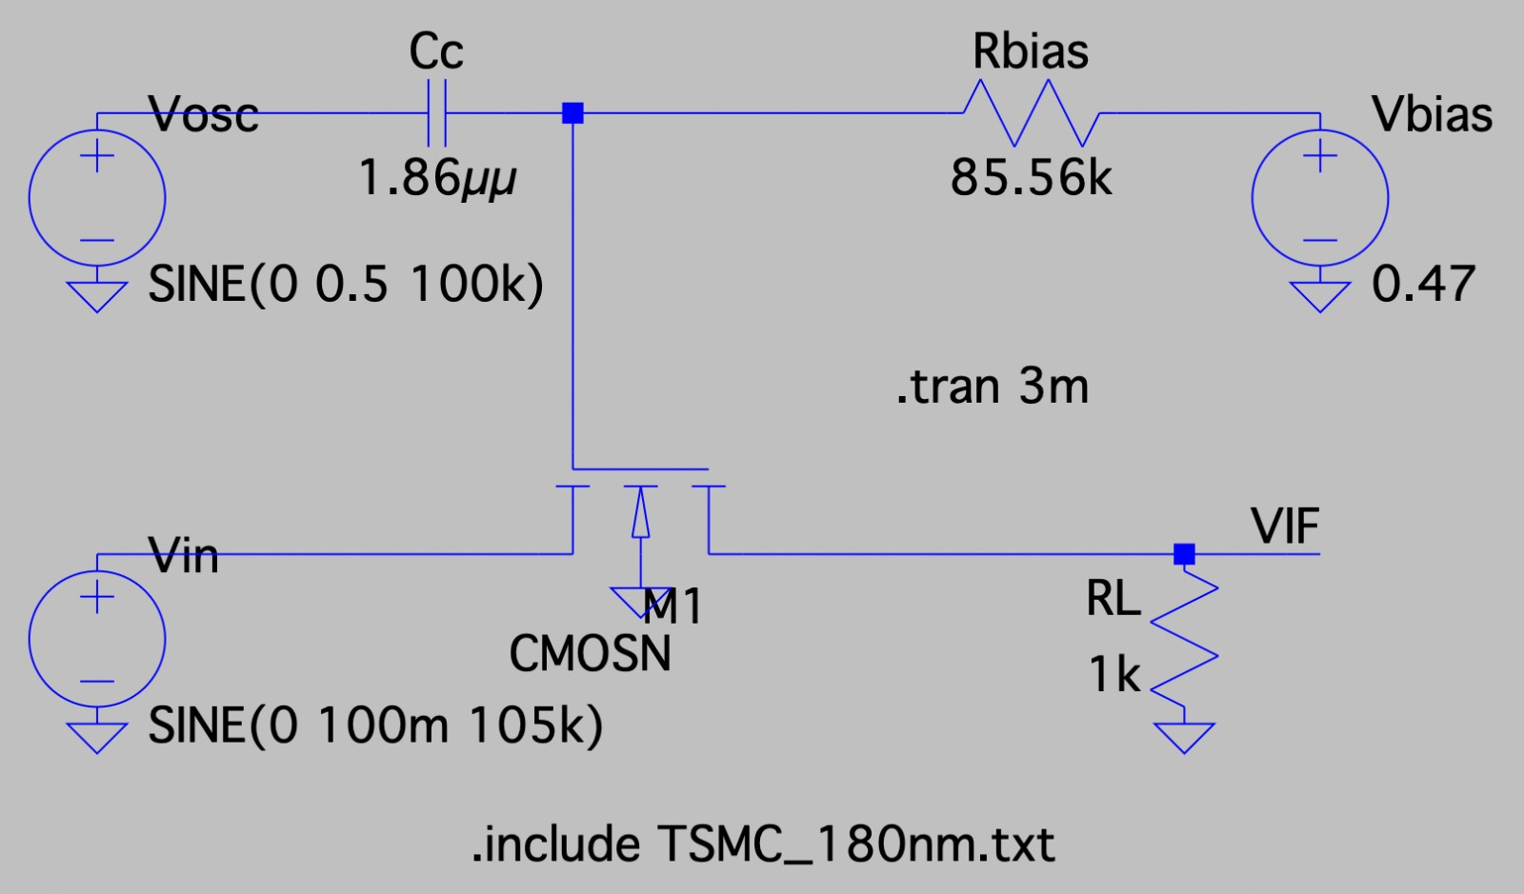
DESIGNED CIRCUIT:

Slide 28
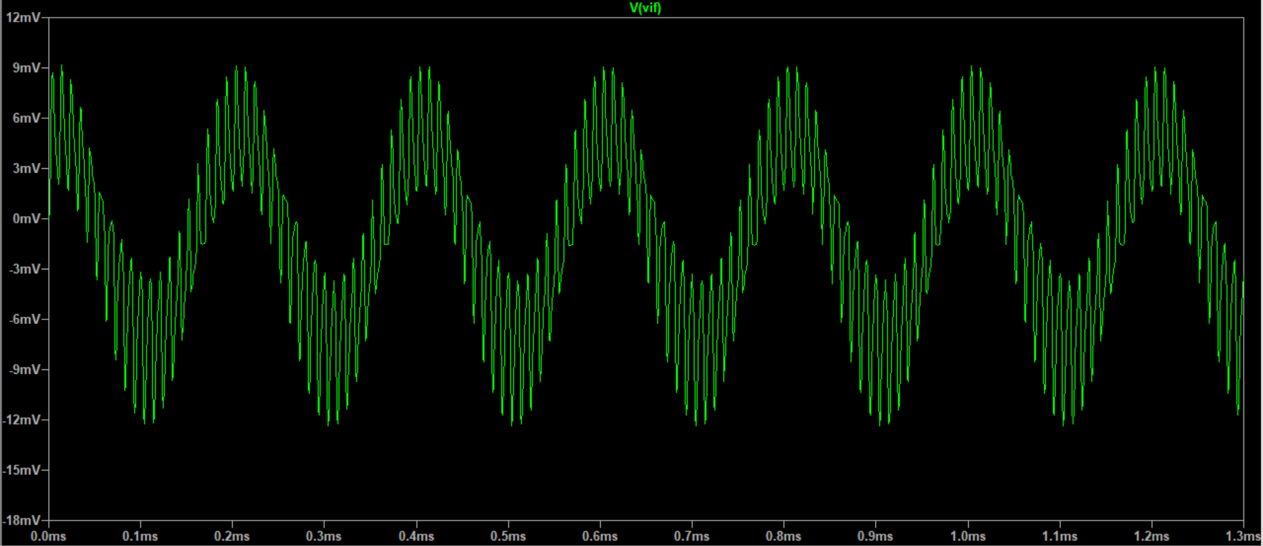
Frequency = 95kHz

Slide 29
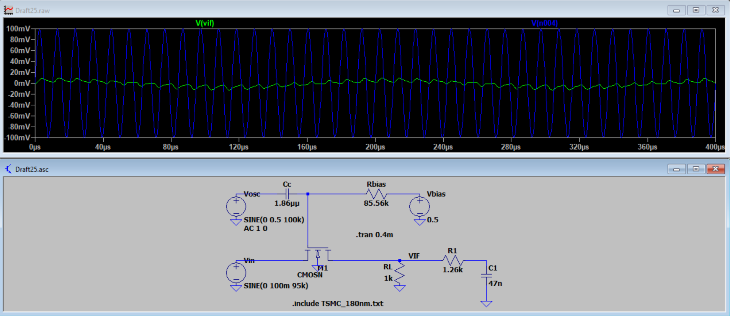
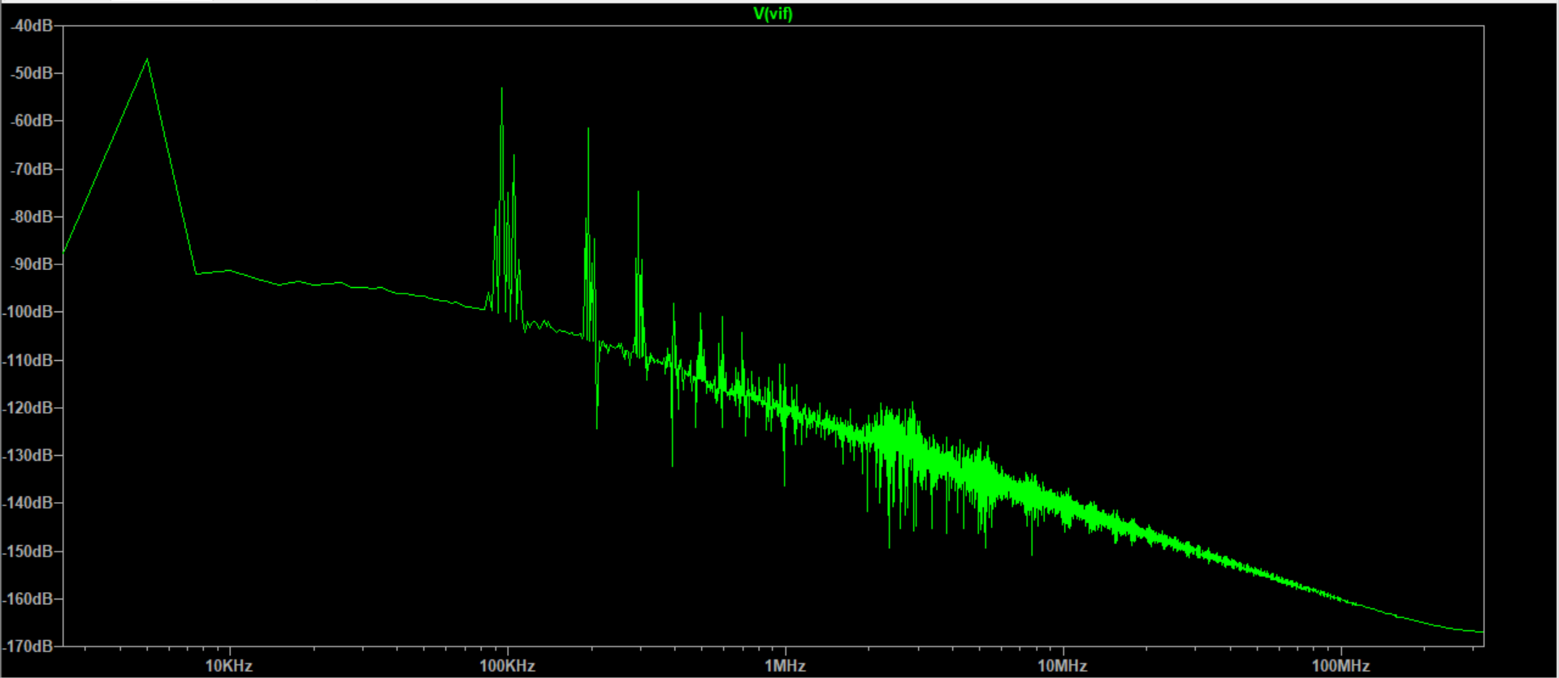
Frequency = 95kHz
Transient response of Vin vs Vif
FFT plot of Vif

Slide 30
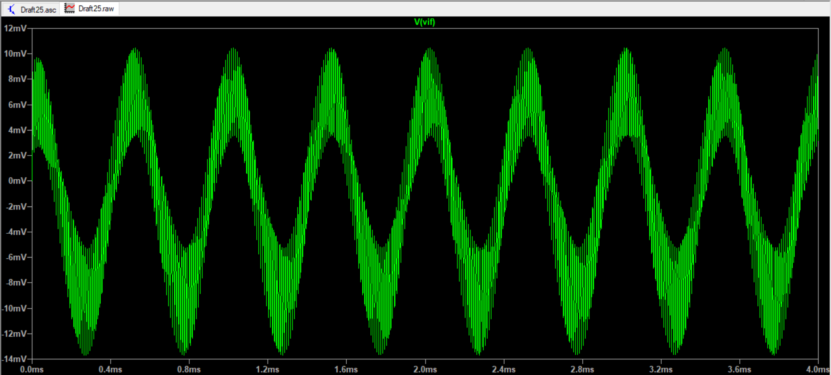
Frequency = 98kHz

Slide 31
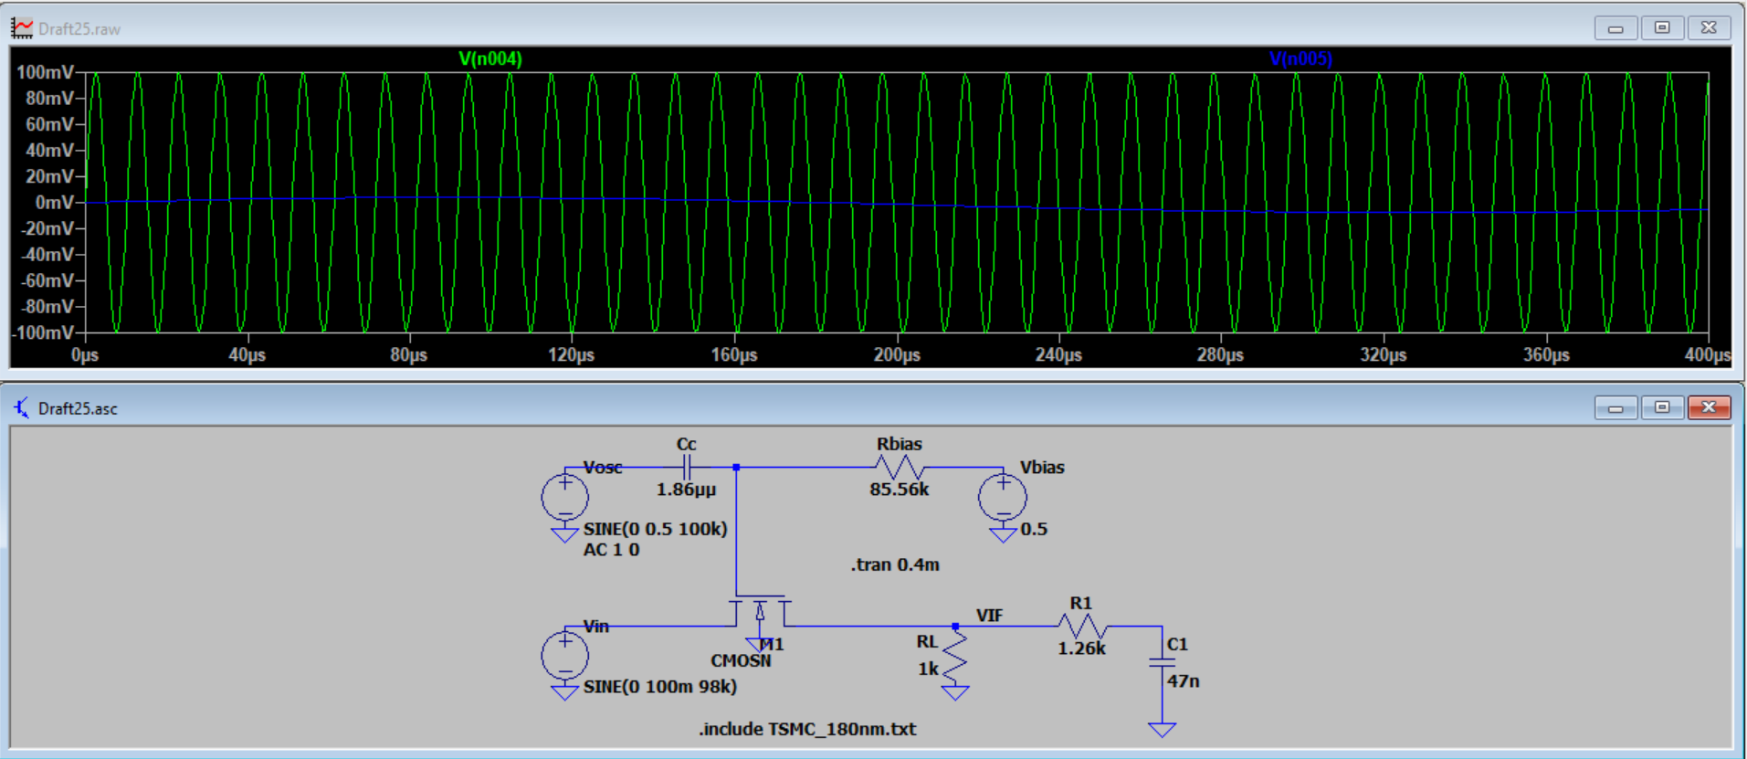
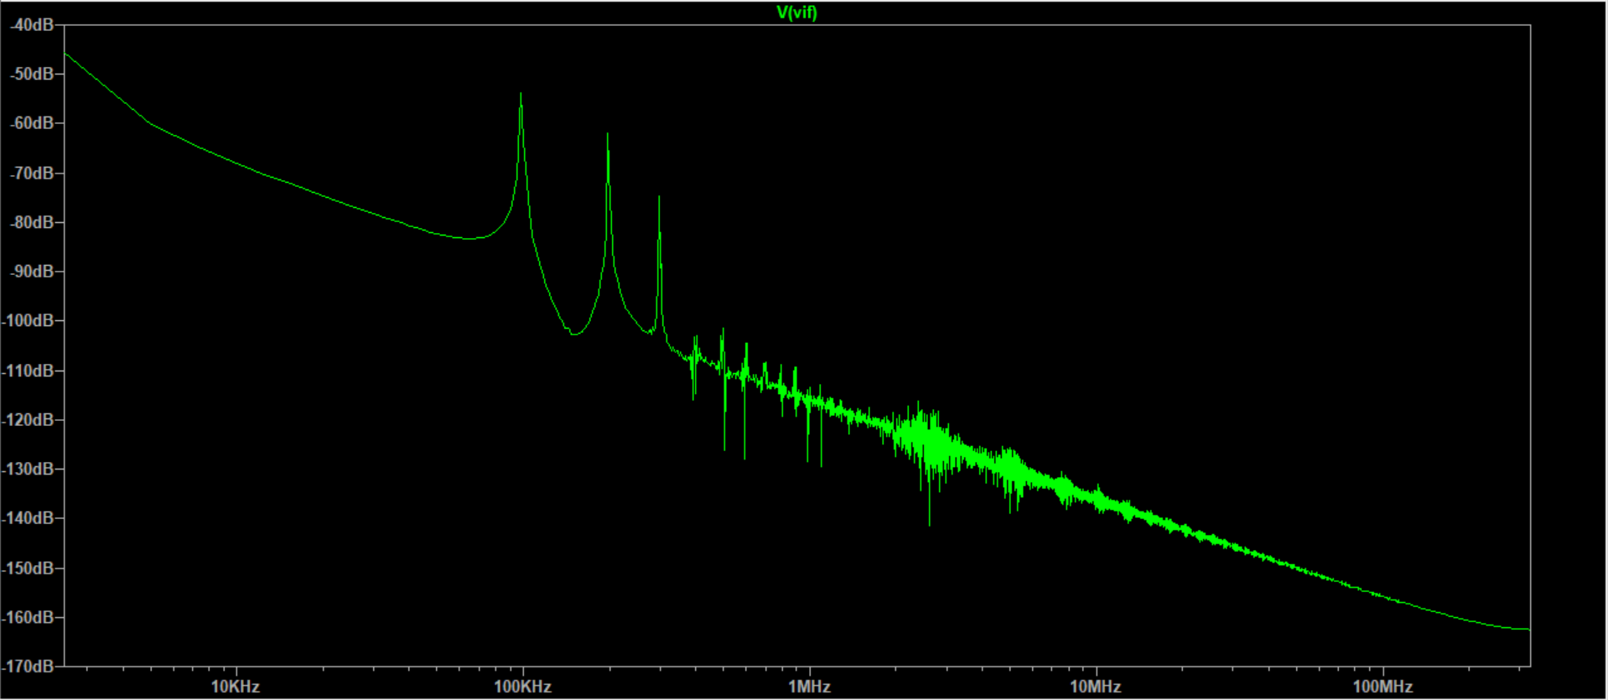
Frequency = 98kHz
Transient response of Vin vs Vif
FFT plot of Vif

Slide 32
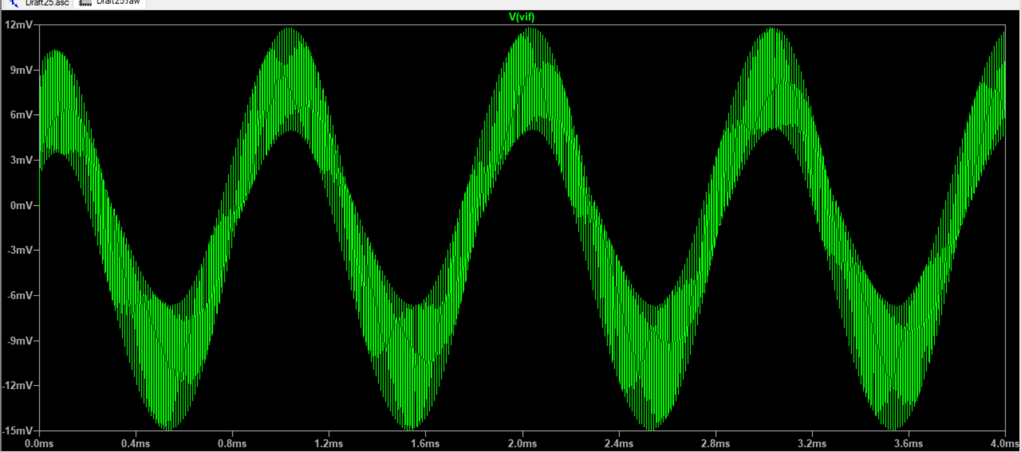
Frequency = 99kHz

Slide 33
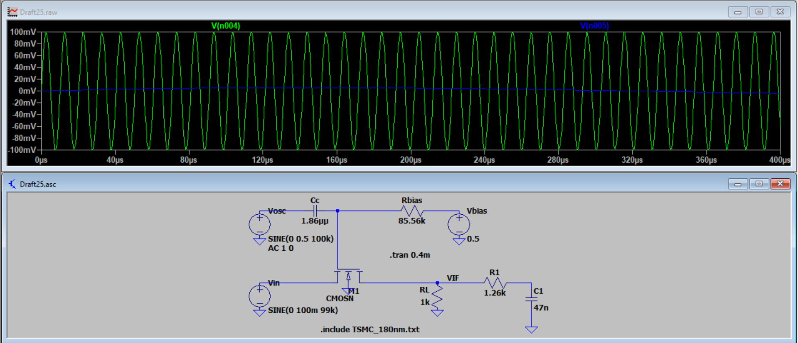
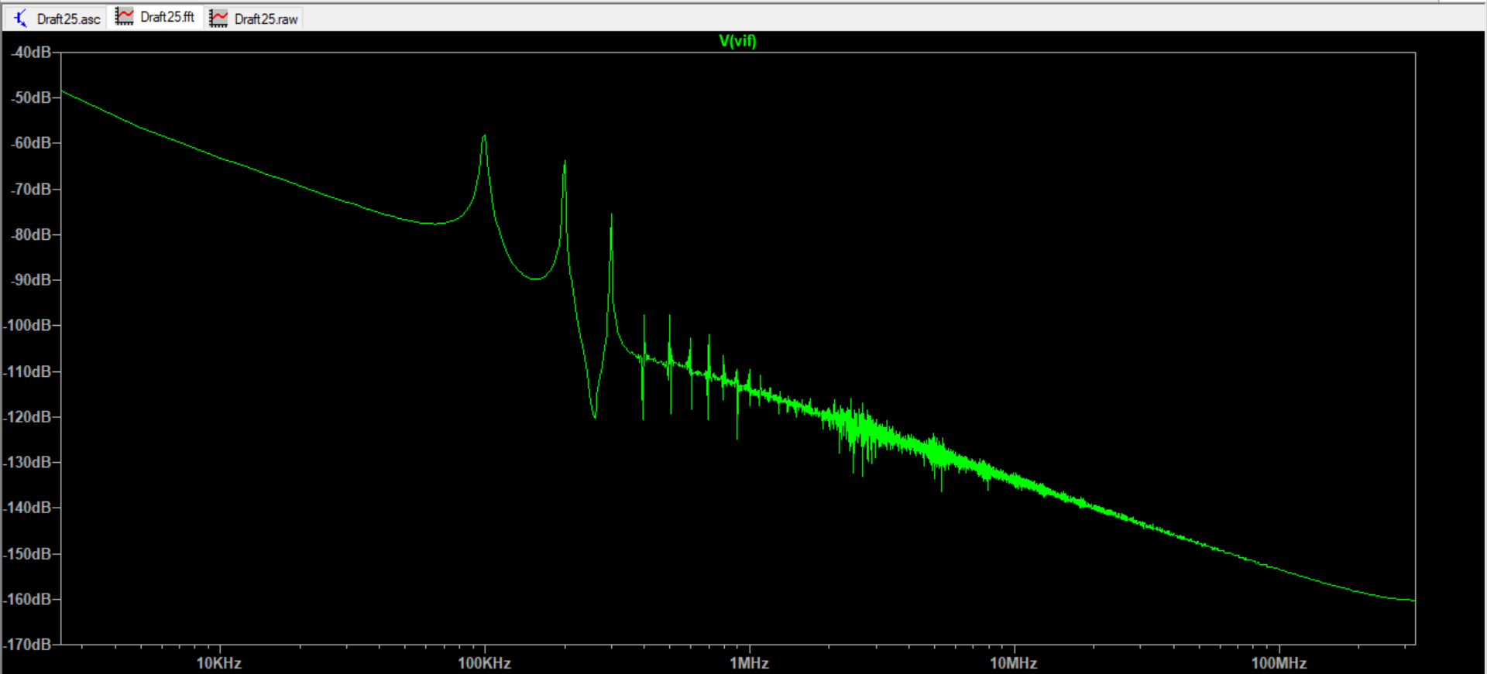
Frequency = 99kHz
Transient response of Vin vs Vif
FFT plot of Vif

Slide 34
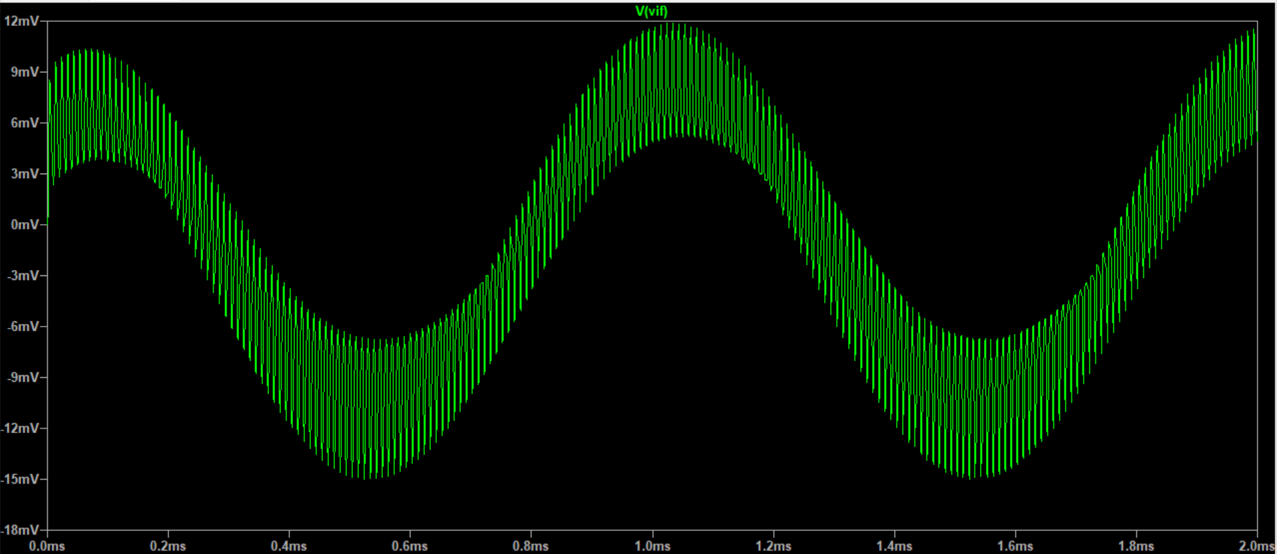
Frequency = 101kHz

Slide 35
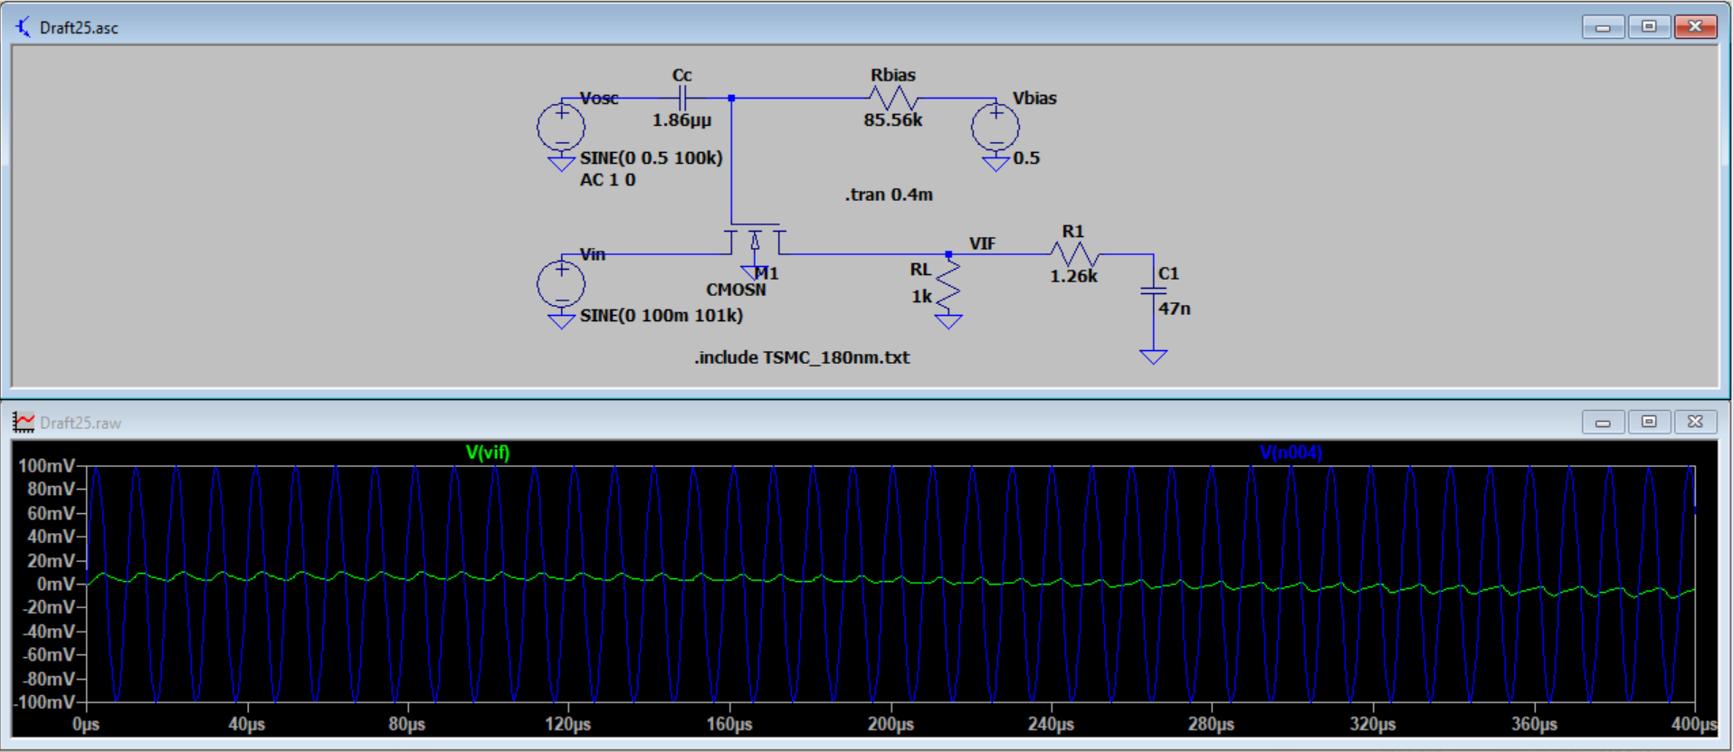
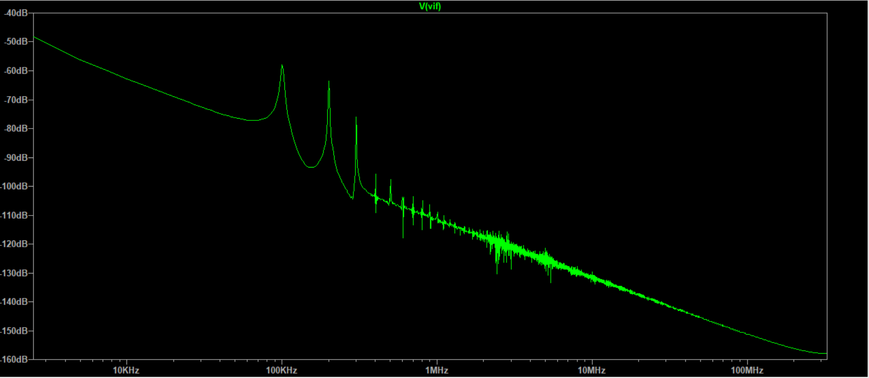
Frequency = 101kHz
Transient response of Vin vs Vif
FFT plot of Vif

Slide 36
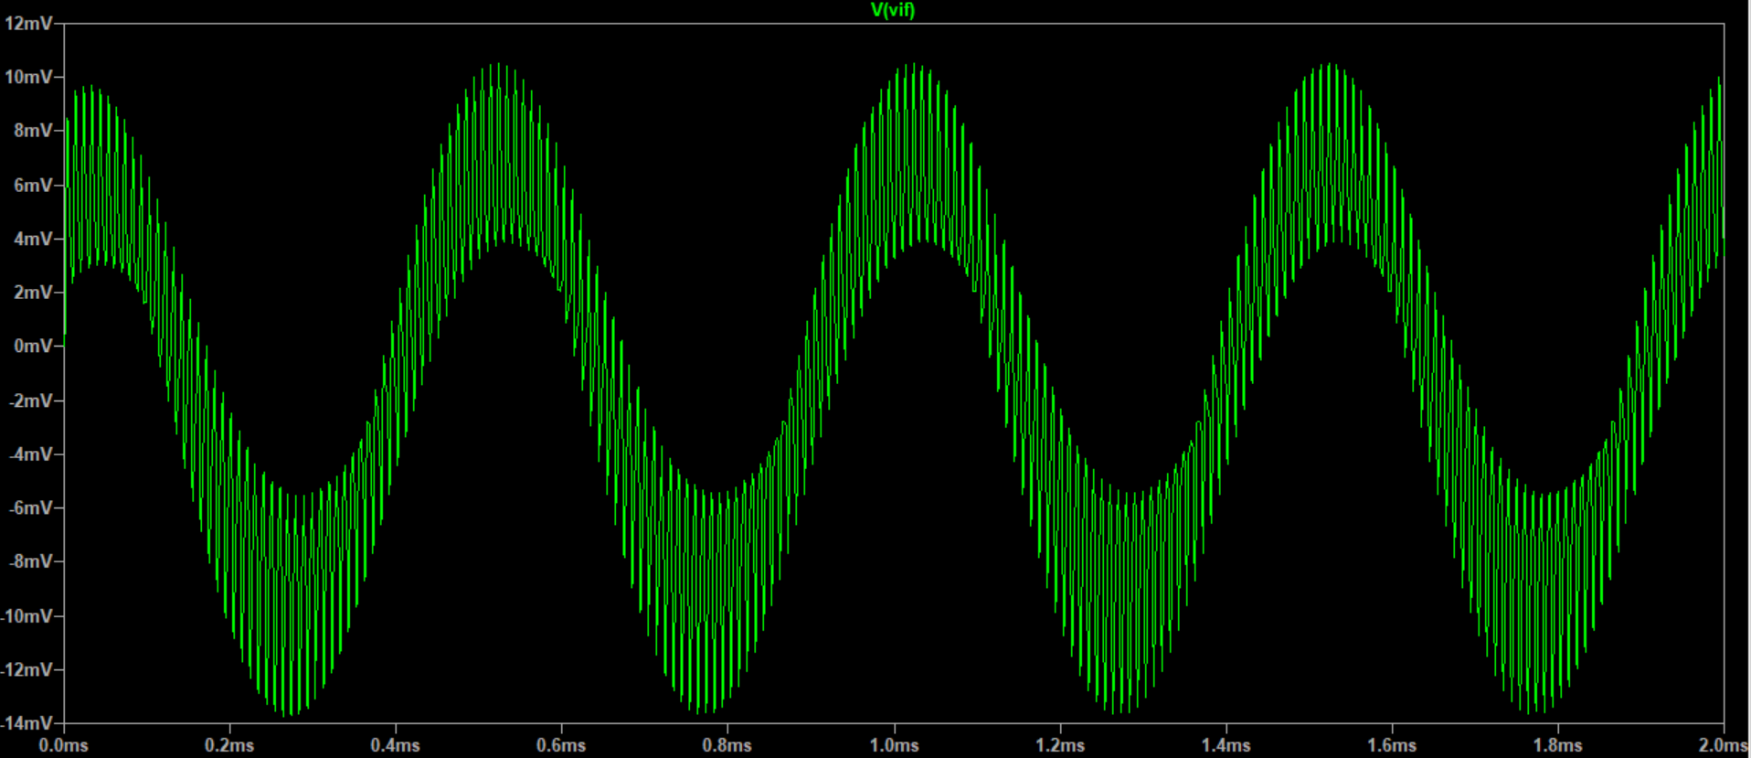
Frequency = 102kHz

Slide 37
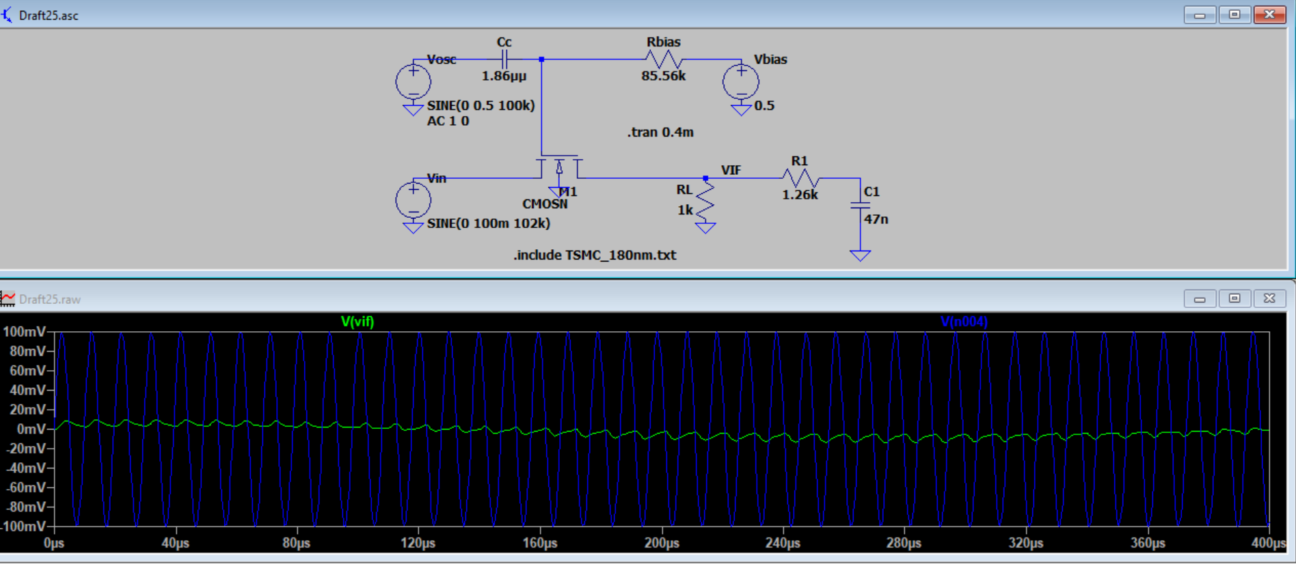
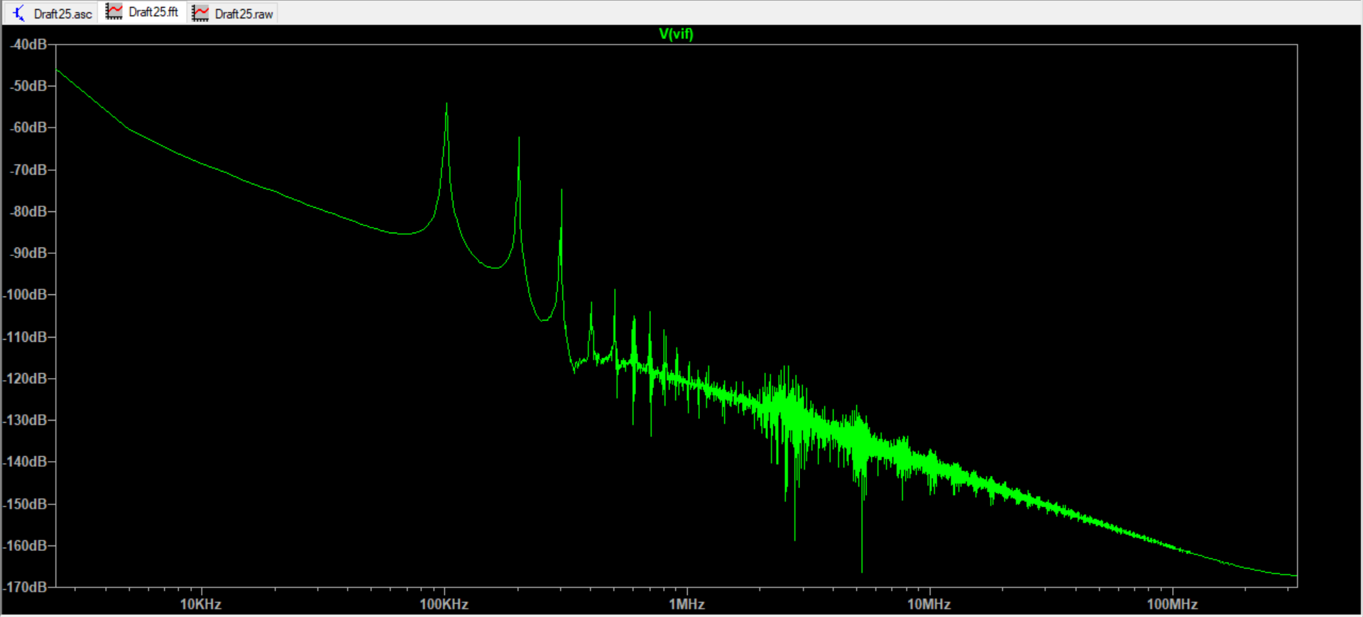
Frequency = 102kHz
Transient response of Vin vs Vif
FFT plot of Vif

Slide 38
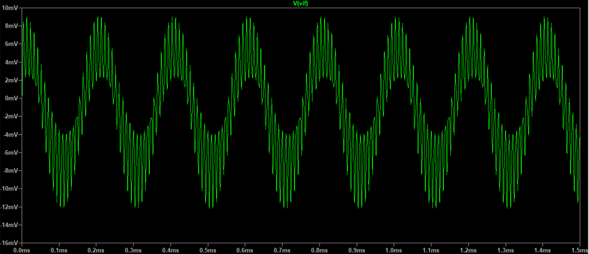
Frequency = 105kHz

Slide 39
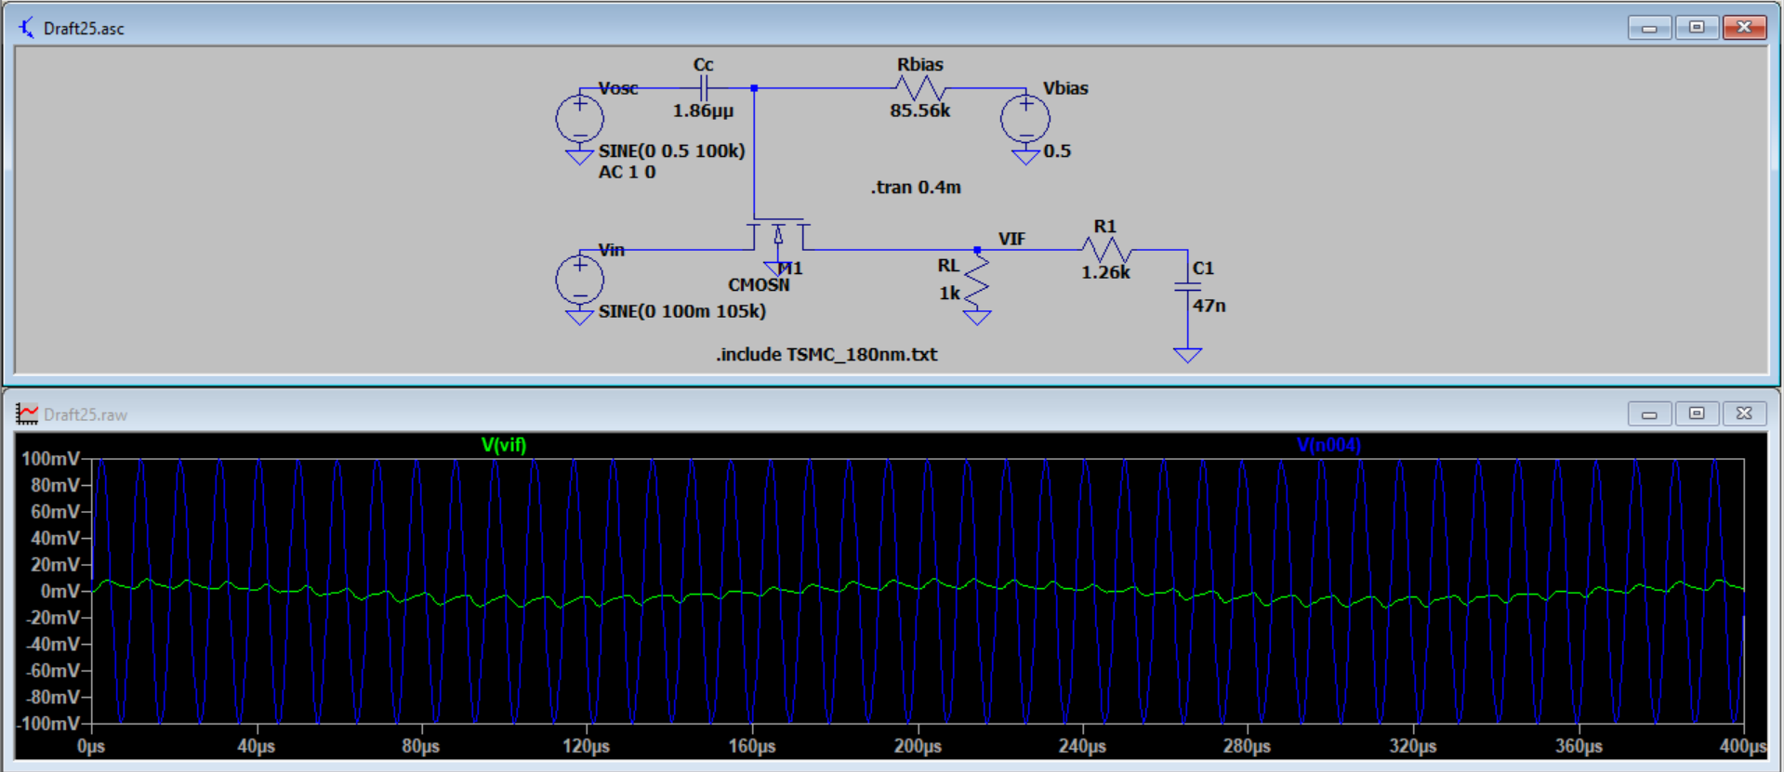
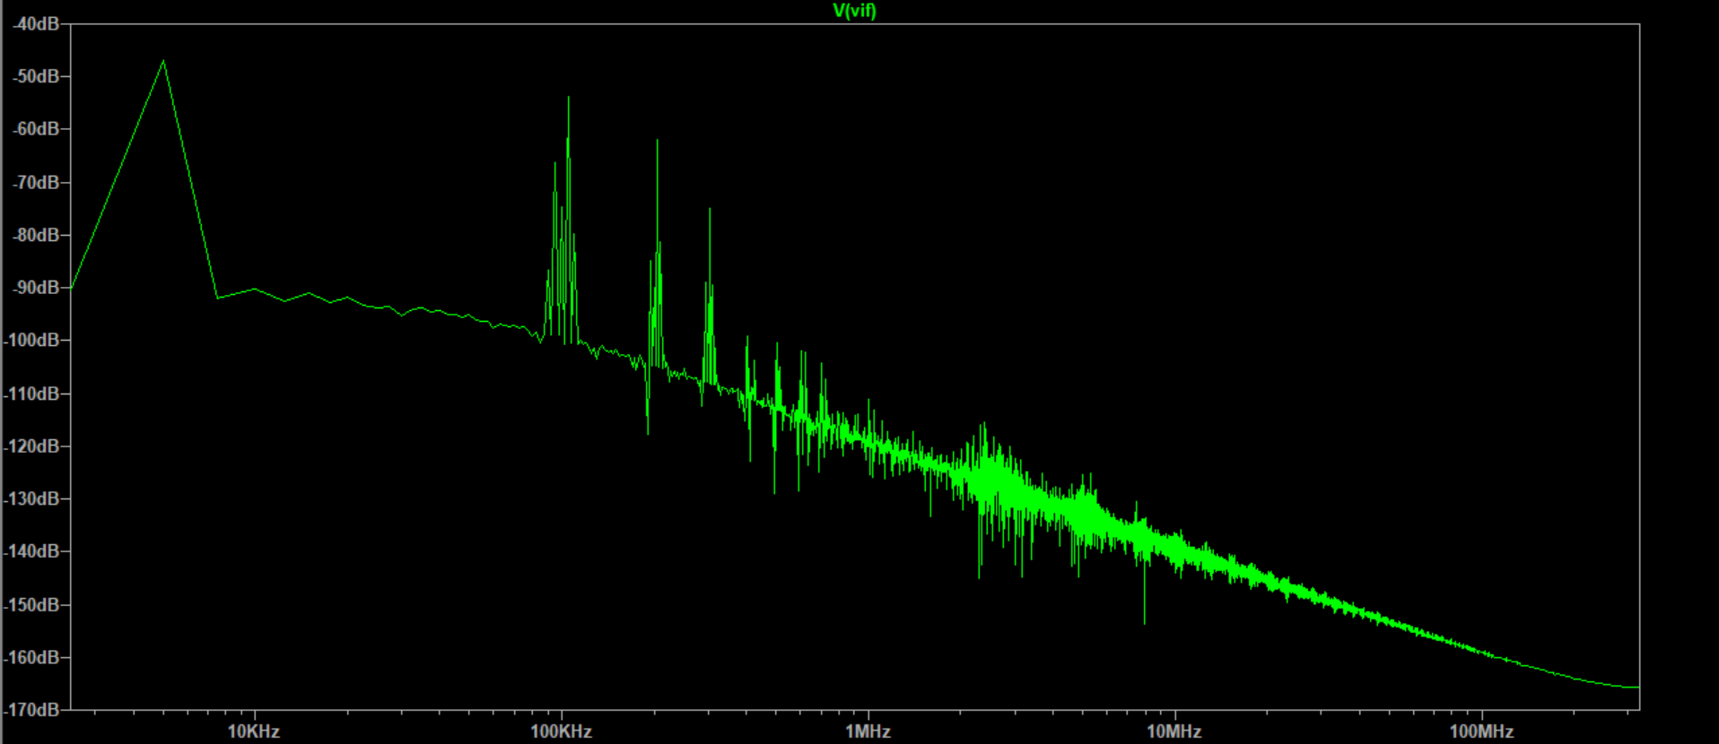
Frequency = 105kHz
Transient response of Vin vs Vif
FFT plot of Vif

